Slide 1
IEEE Section Education Committee (SEOC)
Meeting - 7 June 2023
Deyasini Majumdar, Chair

Slide 2
Meeting Agenda
Welcome & Roll Call
IEEE eLearning 50% Discount
Finalize 5 Year Strategic Plan Input
Climate Change
Questions

Slide 3

SEOC
Deyasini Majumdar, Chair

Slide 4

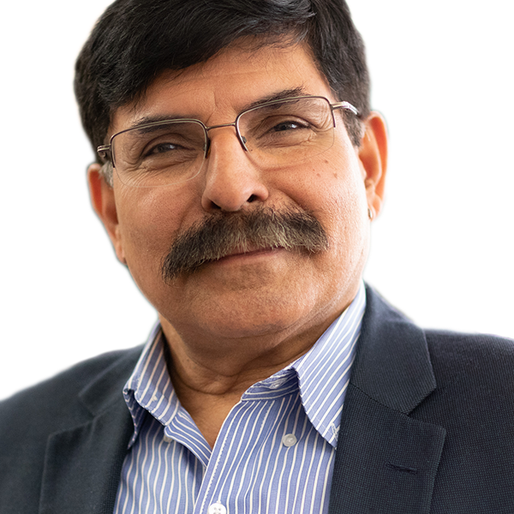
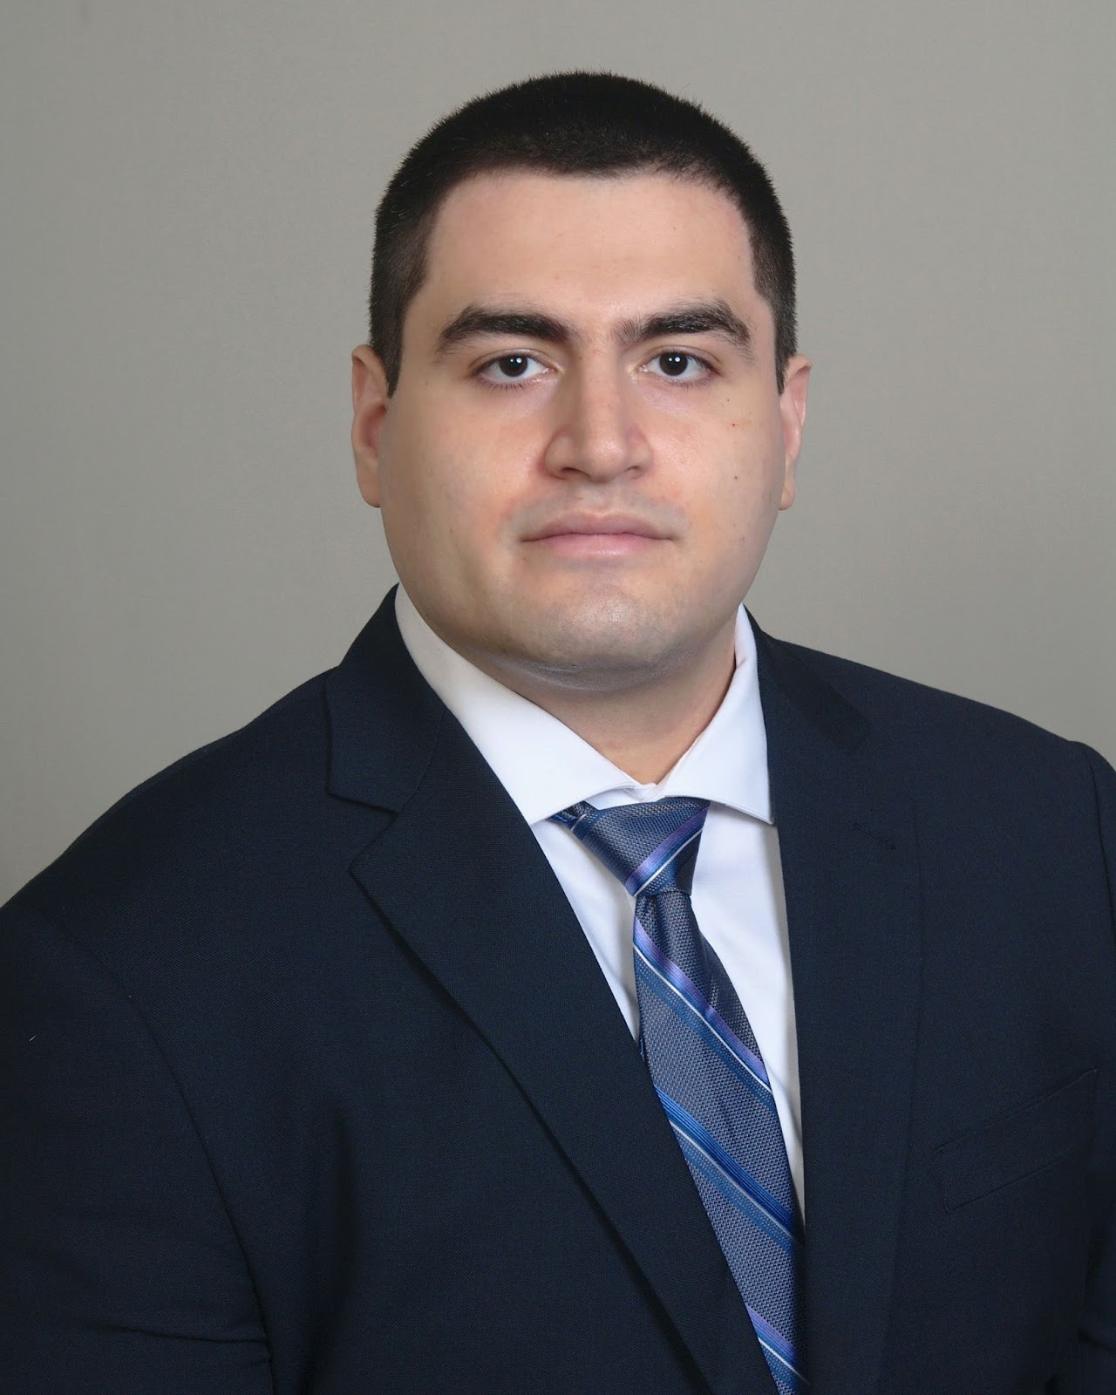


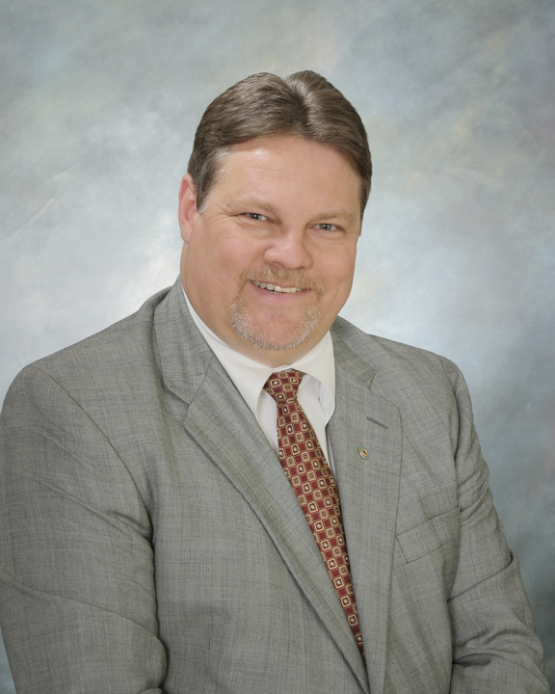
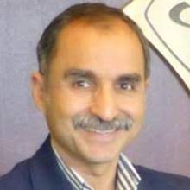


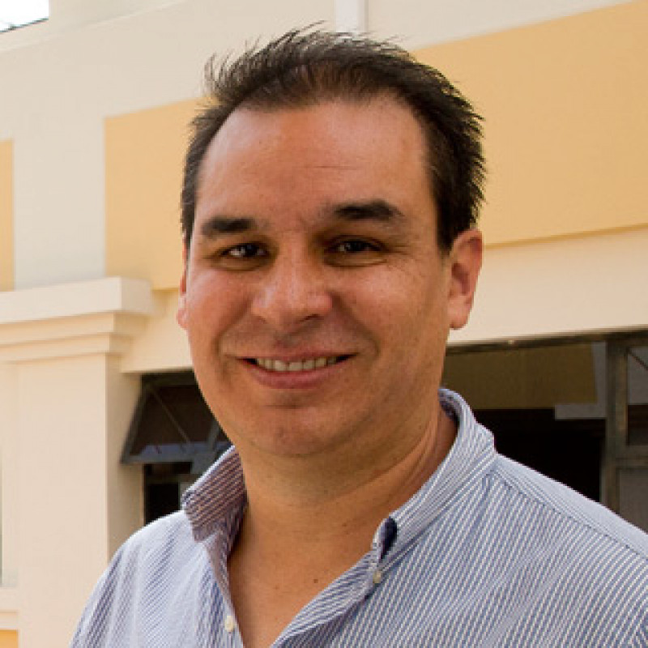
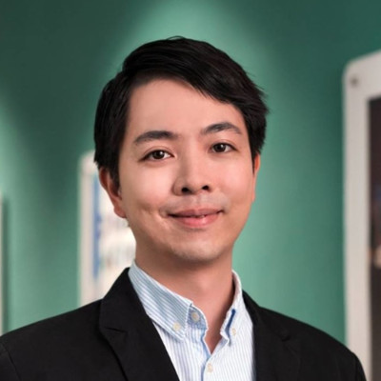
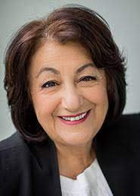


2023 SEOC Committee Members
Deyasini Majumdar SEOC Chair & MGA Representative, R1 | ]\ Lorena Garcia MGA Representative, R7 | Durga Misra Region 1 Representative | Shayan (Sean) Taheri Region 2 Representative | Damith Wickramanayake Region 3 Representative | Anu Gokhale Region 4 Representative | Donald Dunn Donald Dunn Region 5 Representative
Mostafa Mortezaie Region 6 Representative | Asadollah Norouzi Region 7 Representative | Andrejs Romanovs Region 8 Representative | Diego Benitez Mejia Region 9 Representative | Chi Un (Leon) Lei Region 10 Representative | Rabab Ward EAB Vice President, R7 | Staff support Rachel O. Warnick Jordanna Coyle

Slide 5
Meeting Agenda
Welcome & Roll Call
IEEE eLearning 50% Discount
Finalize 5 Year Strategic Plan Input
Climate Change
Questions

Slide 6
New Member Discount:
Save an Additional 50% on IEEE eLearning

Slide 7
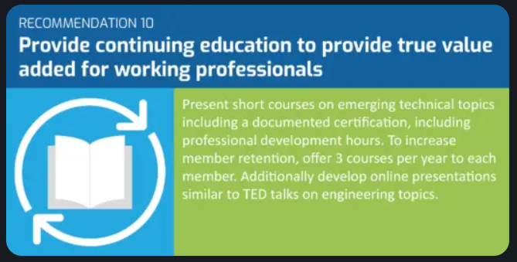
New Member Discount: Save an Additional 50% on IEEE eLearning
How did we get here?
As a result of IEEE Sections Congress 2020, IEEE members voted on three recommendations, including one to provide continuing education to provide true value added for working professionals.
One of the efforts included in this recommendation was to support member retention by offering three IEEE eLearning courses per year to members.

Slide 8
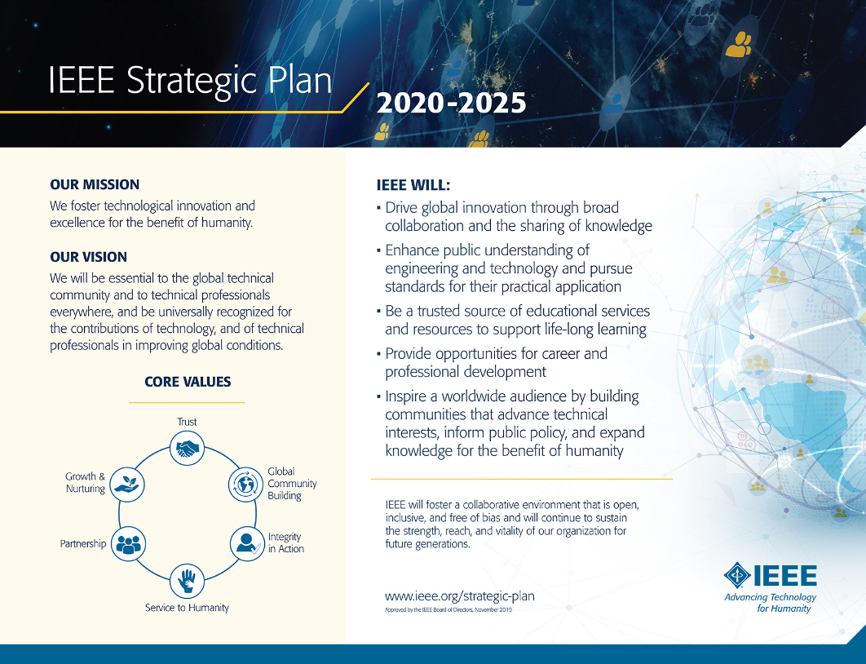
New Member Discount: Save an Additional 50% on IEEE eLearning
How did we get here?
This effort also aligns with the IEEE Strategic Plan for 2020-2025, particularly the Institute’s goals to:
Be a trusted source of educational services and resources to support life-long learning
Provide opportunities for career and professional development

Slide 9
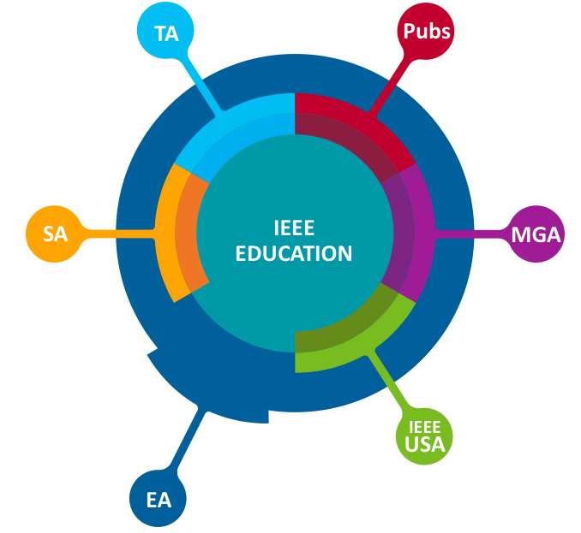
New Member Discount: Save an Additional 50% on IEEE eLearning
How did we get here?
Many areas of IEEE provide eLearning and continuing education products

Slide 10
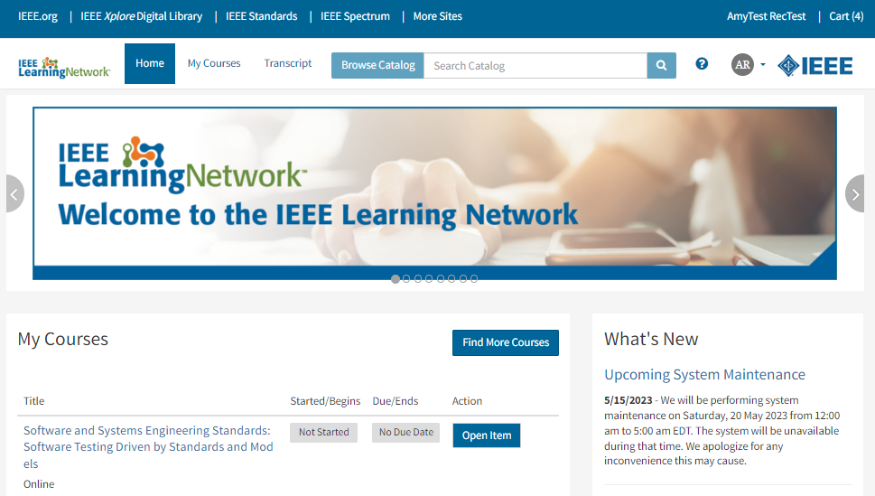
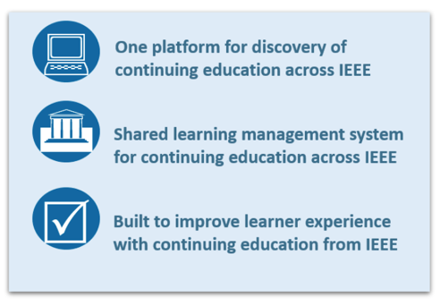
Notes:
Much of this continuing professional education can be found on the recently launched IEEE Learning Network, which features over 1,000 courses in engineering, technology, and career development. The IEEE Learning Network, or ILN, brings together content in an easy-to-use portal and learning management system that lets learners easily search for specific topics or technologies, keep track of your progress in each course, and even instantly print certificates upon successful completion of course assessments.

Slide 11







































41 IEEE Partners on ILN
Intellectual Property Rights

Slide 12
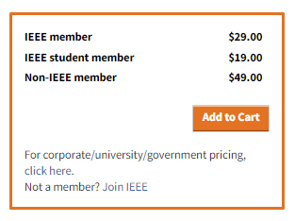
New Member Discount: Save an Additional 50% on IEEE eLearning
How is this different than existing discounts?
The vast majority of ILN courses already offer a member rate
Functionality already existed within the IEEE enterprise cart to allow for additional discounts using a promotion code or promotion link
It was essential that this discount present itself to members during the checkout process so that members don’t need to remember/possess a promotion code or link
Many teams across IEEE OUs and staff worked together to create this IEEE enterprise cart functionality. A great example of working across the aisle!

Slide 13

New Member Discount: Save an Additional 50% on IEEE eLearning
What does this discount include?
Now, members can choose from 300+ courses to save an additional 50% on three eLearning courses per member year!

Slide 14

New Member Discount: Save an Additional 50% on IEEE eLearning
What does this discount include?
Topics include courses in:
Career Development
Computing and Processing
Emerging Technologies
Power, Energy and Industry Applications
Transportation
And more!
(If your Society or OU offers educational content via ILN and wants to include their content in this offer, email ILNinfo@ieee.org)

Slide 15
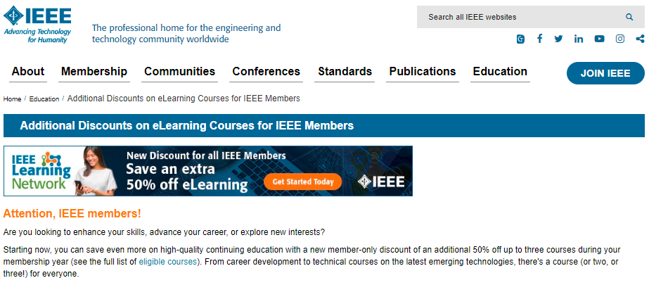
New Member Discount: Save an Additional 50% on IEEE eLearning
How can I access this offer?
You MUST be an active IEEE member.
Identify up to three eligible courses to purchase.
Visit the IEEE Learning Network and sign in with your IEEE personal account (the same account you use to purchase/renew your IEEE membership)
Search for the courses you’re interested in and add them to your cart. Proceed to checkout.
The additional 50% discount will automatically be available via the Payment page during checkout. Be sure to select the products you wish to discount and click “Apply Discount Selection” before proceeding to the Review Order page.
Complete your purchase.
Start learning! Your course is available immediately on-demand.
Visit www.ieee.org/education/mud.html
A step-by-step guide walks you through the process

Slide 16
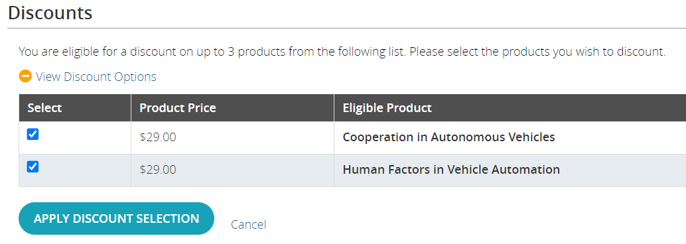
New Member Discount: Save an Additional 50% on IEEE eLearning
What else should I know?
Remember to apply your discount selection on the Payment page in order to receive your discount.
Don’t want to buy all three courses at once? You can take advantage of this offer until the end of this membership year, and can purchase the courses in up to three separate transactions.
Plus: After you renew your membership for the next year, your eligibility will restart and you will be able to access three more courses at this special rate!

Slide 17
Visit the IEEE Brand Experience Toolkit:
brand-experience.ieee.org/toolkits/ieee-elearning-discount
Share Within Your Networks
How can we do that?
You will find:
Social media copy
Newsletter blurb copy
Variety of images in different sizes (static + animated)
180x150
300x250
600x200
728x90
200x628
1300x280
Share the information with your members via:
Social media channels
Newsletters
E-mail campaigns
Websites
Anywhere your members receive digital information

Slide 18


Slide 19


Slide 21


Slide 22


Slide 23
Share Within Your Networks
Where else can we find information about this offer?
MGA placement
Arrears messaging
Member Benefit Bulletins throughout the year
Lead gen program
Renewals messaging in the fall
E-mail banners
New member benefit for 2024
Message in the New Member Onboarding
Message the post-renewal engagement series
EA placement
ILN carousel image
Built into EA marketing/promo efforts via email, social media, newsletters + more!
Other placement
IEEE Brand Experience website
IEEE.org homepage
SCOOP, Society Sentinel, TA, IEEE-OU promotion
IEEE social media alias
Sections Congress
Include in communications/emails to members about Sections Congress
Include a flyer in the attendee bags + with anyone who will have a table
Share ad for rolling screen
Share a presentation/slide with people presenting

Slide 24

Questions?
CPEsupport@ieee.org

Slide 25
EAB 5 Year Strategy
Section Education Outreach Committee

Slide 26
Section Education Outreach Committee - SEOC Market Strategy
Section & Chapter volunteers
Concise understanding of EA programs, to enable promotion
Newsletter, direct emails, social media, website
Webinars (training)
Face to face training (building relationships)
Approx 250 sections (w/REACs in room) 30% penetration rate
Limited opportunity on diversity, but should mention to MGA. Diversity of technical areas. Opportunity for SEOC to support diversity through Local Languages (R8, 9, 10) Interest in R 9, 10 - Additional support would not be needed, but opportunity to showcase
Clarity on who the committee is serving.
What are the wants and needs of those we are serving?
How can they be reached?
What is the size of the market?
What can be done to increase diversity in participation for these chosen markets?

Slide 27

Section Education Outreach Committee - SEOC Product & Service Strategy
Listserv, EA Insight, ea.ieee.org - Resources page
One page doc for REAC
Survey in 2023 to understand Section, Chapter volunteer needs
No competitors, but contributors
Challenge for Section, Chapter volunteers is funding resources, time
Focus on member retention, new members (first year and perspective), quality programs to enhance career development
Access to the EA programs (quality programs), access to EA committees, share information with EA volunteers and staff
*Google mentioned*
What products and services we will offer to meet the wants and needs of our markets?
Who are direct competitors for serving the wants and needs?
What will be SEOCs unique value proposition to section volunteers?

Slide 28

Section Education Outreach Committee - SEOC Production Strategy
On ea.ieee.org pages
Need to be added to the region education websites, too.
Volunteer introduction, volunteer training
Multiple ways to delivery -
Region outreach R 10 has to search on their own - working on ways to understand and leverage SAC, WIE, YP avenues, too.
How will execute the Product Strategy?
What is needed to develop and deliver the offering?

Slide 29

Section Education Outreach Committee - SEOC Organizational Strategy
Regional committees
succession planning for REACs
Introduction packet to new REACs
Nominated by region director, input from Education Chair (current)
Consider a vice chair position/chair elect on SEOC create continuity
MGA Region alignment updates may need to be applied
Affinity groups/Society
engagement - possible position or communicate at the regional level
Enhance communication channels to include YP/WIE
Encourage Sections to have education role
Are any significant changes needed to how will the volunteer committees and staff should be organized to execute the production strategy?

Slide 30

Section Education Outreach Committee - SEOC Financial Strategy
Survey incentive
Discount on membership
Funding to attend Sections Congress for REAC to present and staff to support
How do we ensure we will have the funding that will allow us to achieve the strategies?
How will the financial model allow us to expand our impact moving forward?
Can we do it in a sustainable way?

Slide 31
Meeting Agenda
Welcome & Roll Call
IEEE eLearning 50% Discount
Finalize 5 Year Strategic Plan Input
Climate Change
Questions

Slide 32
Climate Change
What activities are ongoing in regions? What are the needs?
Feedback can be offered here.

Slide 33
Meeting Agenda
Welcome & Roll Call
IEEE eLearning 50% Discount
Finalize 5 Year Strategic Plan Input
Climate Change
Questions

Slide 34
Questions?

Slide 35
SEOC @ EAB Mini-Series
Target Objective & Action Plan Review
Target Objectives | Measures of Success
 | Current | Year End 2023
IMPACT/ REACH | Employ email communication to REACs through Listservs populated with education volunteers Distribution of EA Insight, volunteer e-newsletter | Targeted EA Outreach to REAC, SEAC Continue implementation of communication plan w/ guidance, updates & enhancements based on reach metrics Deliver 12 issues of EA Insight Send 12 Listserve promotional messages for REACs to share Distribute 12 Social Media messages for distribution to Region/Section channels
IMPACT/ REACH | EA marketing leverages social media channels to promote programs No clear understanding of what works for Regions/Sections to pass along program info | Identify 2-3 Key Areas/Ways SEOC Can Support Education Volunteers Enhance the Program list on ea.ieee.org, with core purpose and how to leverage by REACs Create promotional avenue for funding deadlines and events with a calendar/ensure advance notice, awareness Address Outreach Challenges Identify who to reach in Sections, How to reach them, How to engage, Identify the Section volunteer needs
IMPACT/ REACH | Education volunteer orientation and overview sessions offered Program specific sessions as requested by Regions/Sections | Need-Based Program Promotion Webinars Develop library and promote opportunities to offer webinars. Provide 2 webinars in 2023 to be added to the webinar library on ea.ieee.org Sections Congress 2023 Session - Supporting Education Volunteers in Your Section: Connect with Your Region Education Coordinator & Engagement ideas at the event
PARTNERSHIP | Introduced inviting committee chairs to participate in SEOC meetings and present to highlight programs | Identify Opportunities for Collaboration with EA Committees Invite committee chairs to SEOC meetings to advise on efforts and provide Regions with promotional materials to support. 8-10 EA programs highlighted throughout the year at appropriate SEOC monthly meetings Engage CEC to share highlight products ease of use, streamline process/outline of what a Section/Region needs to be done. etc. Ex. Credentialing for courses offered Promote Member Discount on 3 ILN Courses

Slide 36
TARGET OBJECTIVE Targeted EA Outreach to REAC, SEAC
ACTION PLAN MILESTONES
2023 Q2 | 2023 Q3 | 2023 Q4 | 2024 Q1 | 2024 Q2
Deliver 12 issues of EA Insight Building list, adding Section Chairs
Send 12 Listserve promotional messages for REACs to share Building list, adding Section Chairs
Distribute 12 Social Media messages for distribution to Region/Section channels

Slide 37
TARGET OBJECTIVE Identify 2-3 Key Areas/Ways SEOC Can Support Education Volunteers
ACTION PLAN MILESTONES
2023 Q2 | 2023 Q3 | 2023 Q4
Enhance the Program list on ea.ieee.org, with core purpose and how to leverage by REACs Align w/one page flyer to include core purpose, how to implement at the Section level, how to fund/funding opportunities | SEOC chair to draft for EPICS in IEEE program as template | Develop for other EA programs
Create promotional avenue for funding deadlines and events with a calendar/ensure advance notice, awareness | See above
Address Outreach Challenges Identify who to reach in Sections, How to reach them, How to engage, Identify the Section volunteer needs | Survey to be developed for Section Education and Section Chairs | Survey to be sent and results reviewed

Slide 38
Need-Based Program Promotion Webinars
ACTION PLAN MILESTONES
2023 Q2 | 2023 Q3 | 2023 Q4
Participation in IEEE Education Week with webinar, Adding Value to Your Section/Community - Tools for IEEE Education Volunteers | Participation in IEEE Sections Congress session, Supporting Education Volunteers in Your Section: Connect with Your Region Education Coordinator Plan webinar based on interest from REAC, SEAC - Tentative topic Credentials offered for Technical Programs

Slide 39
Identify Opportunities for Collaboration with EA Committees
ACTION PLAN MILESTONES
2023 Q2 | 2023 Q3 | 2023 Q4
Q1 Program Updates: EAB Awards Program IEEE Education Week IEEE STEM Grants - Promotion IEEE Teaching Excellence Hub IEEE Multiple Use Discount - 3 courses additional 50% off to IEEE Members | IEEE STEM Summit IEEE Credentialing Program EPICS in IEEE | TBD

